Slide 1
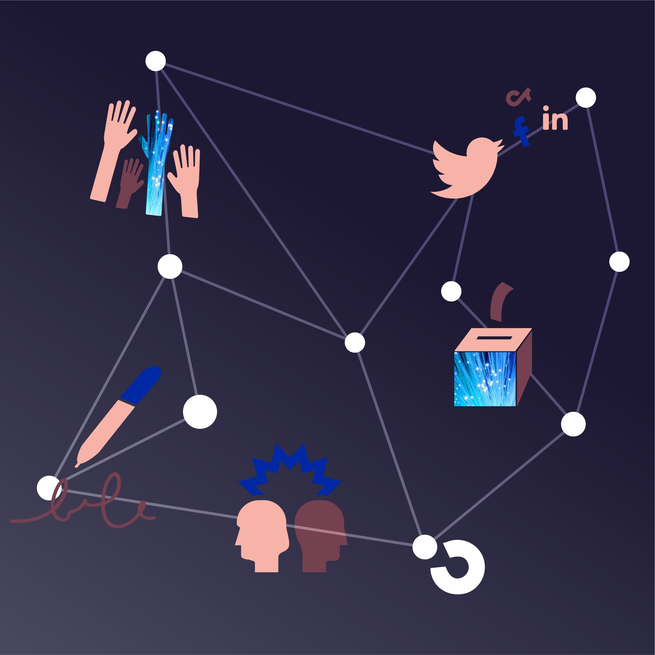
DSI AI Meetup
Best Practices in Deploying AI at Scale
Presenters Maël Kubli (UZH)
Colin Henry (UZH)

Slide 2

The DSI Community Democracy
DSI: Digital Society Initiative
Community Democracy: Benefits & risks of digitalization for democracy and society
Interdisciplinary research & projects
Outreach to stakeholders & the broader public
Development of practical approaches & solutions

Slide 3
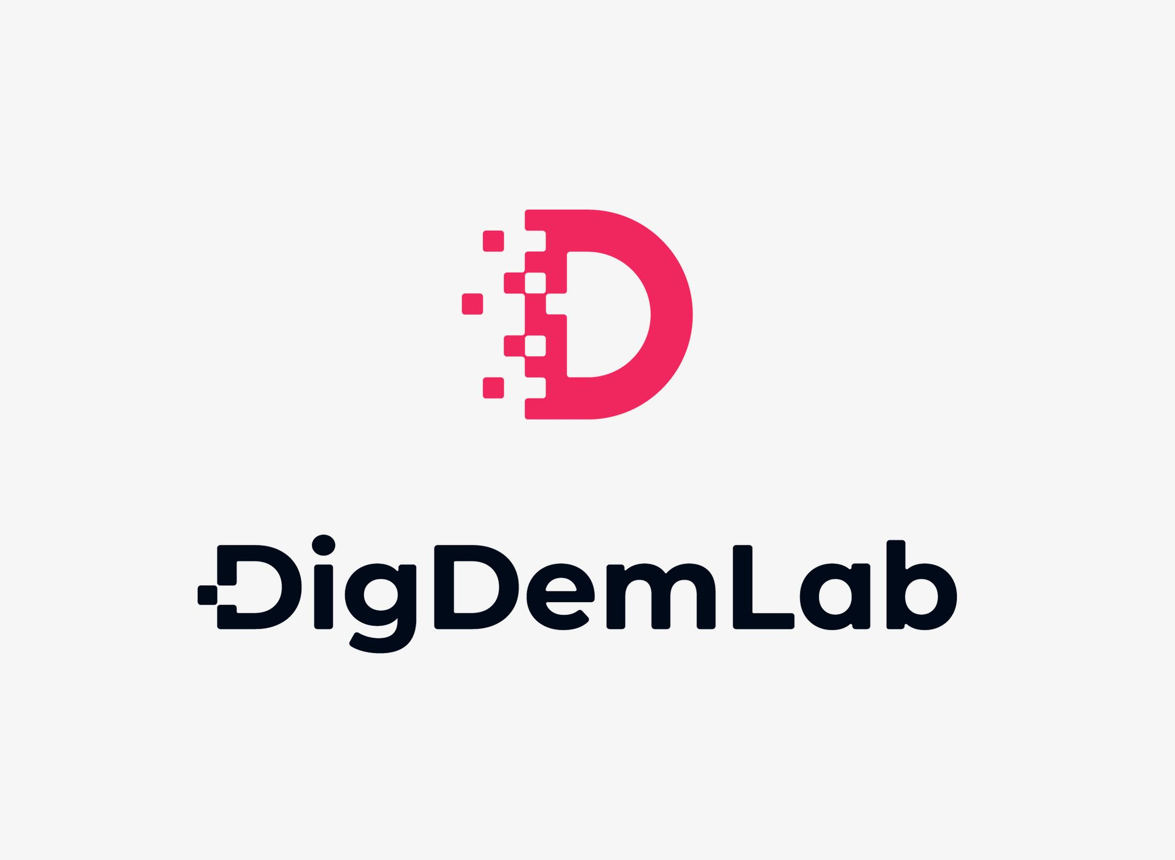

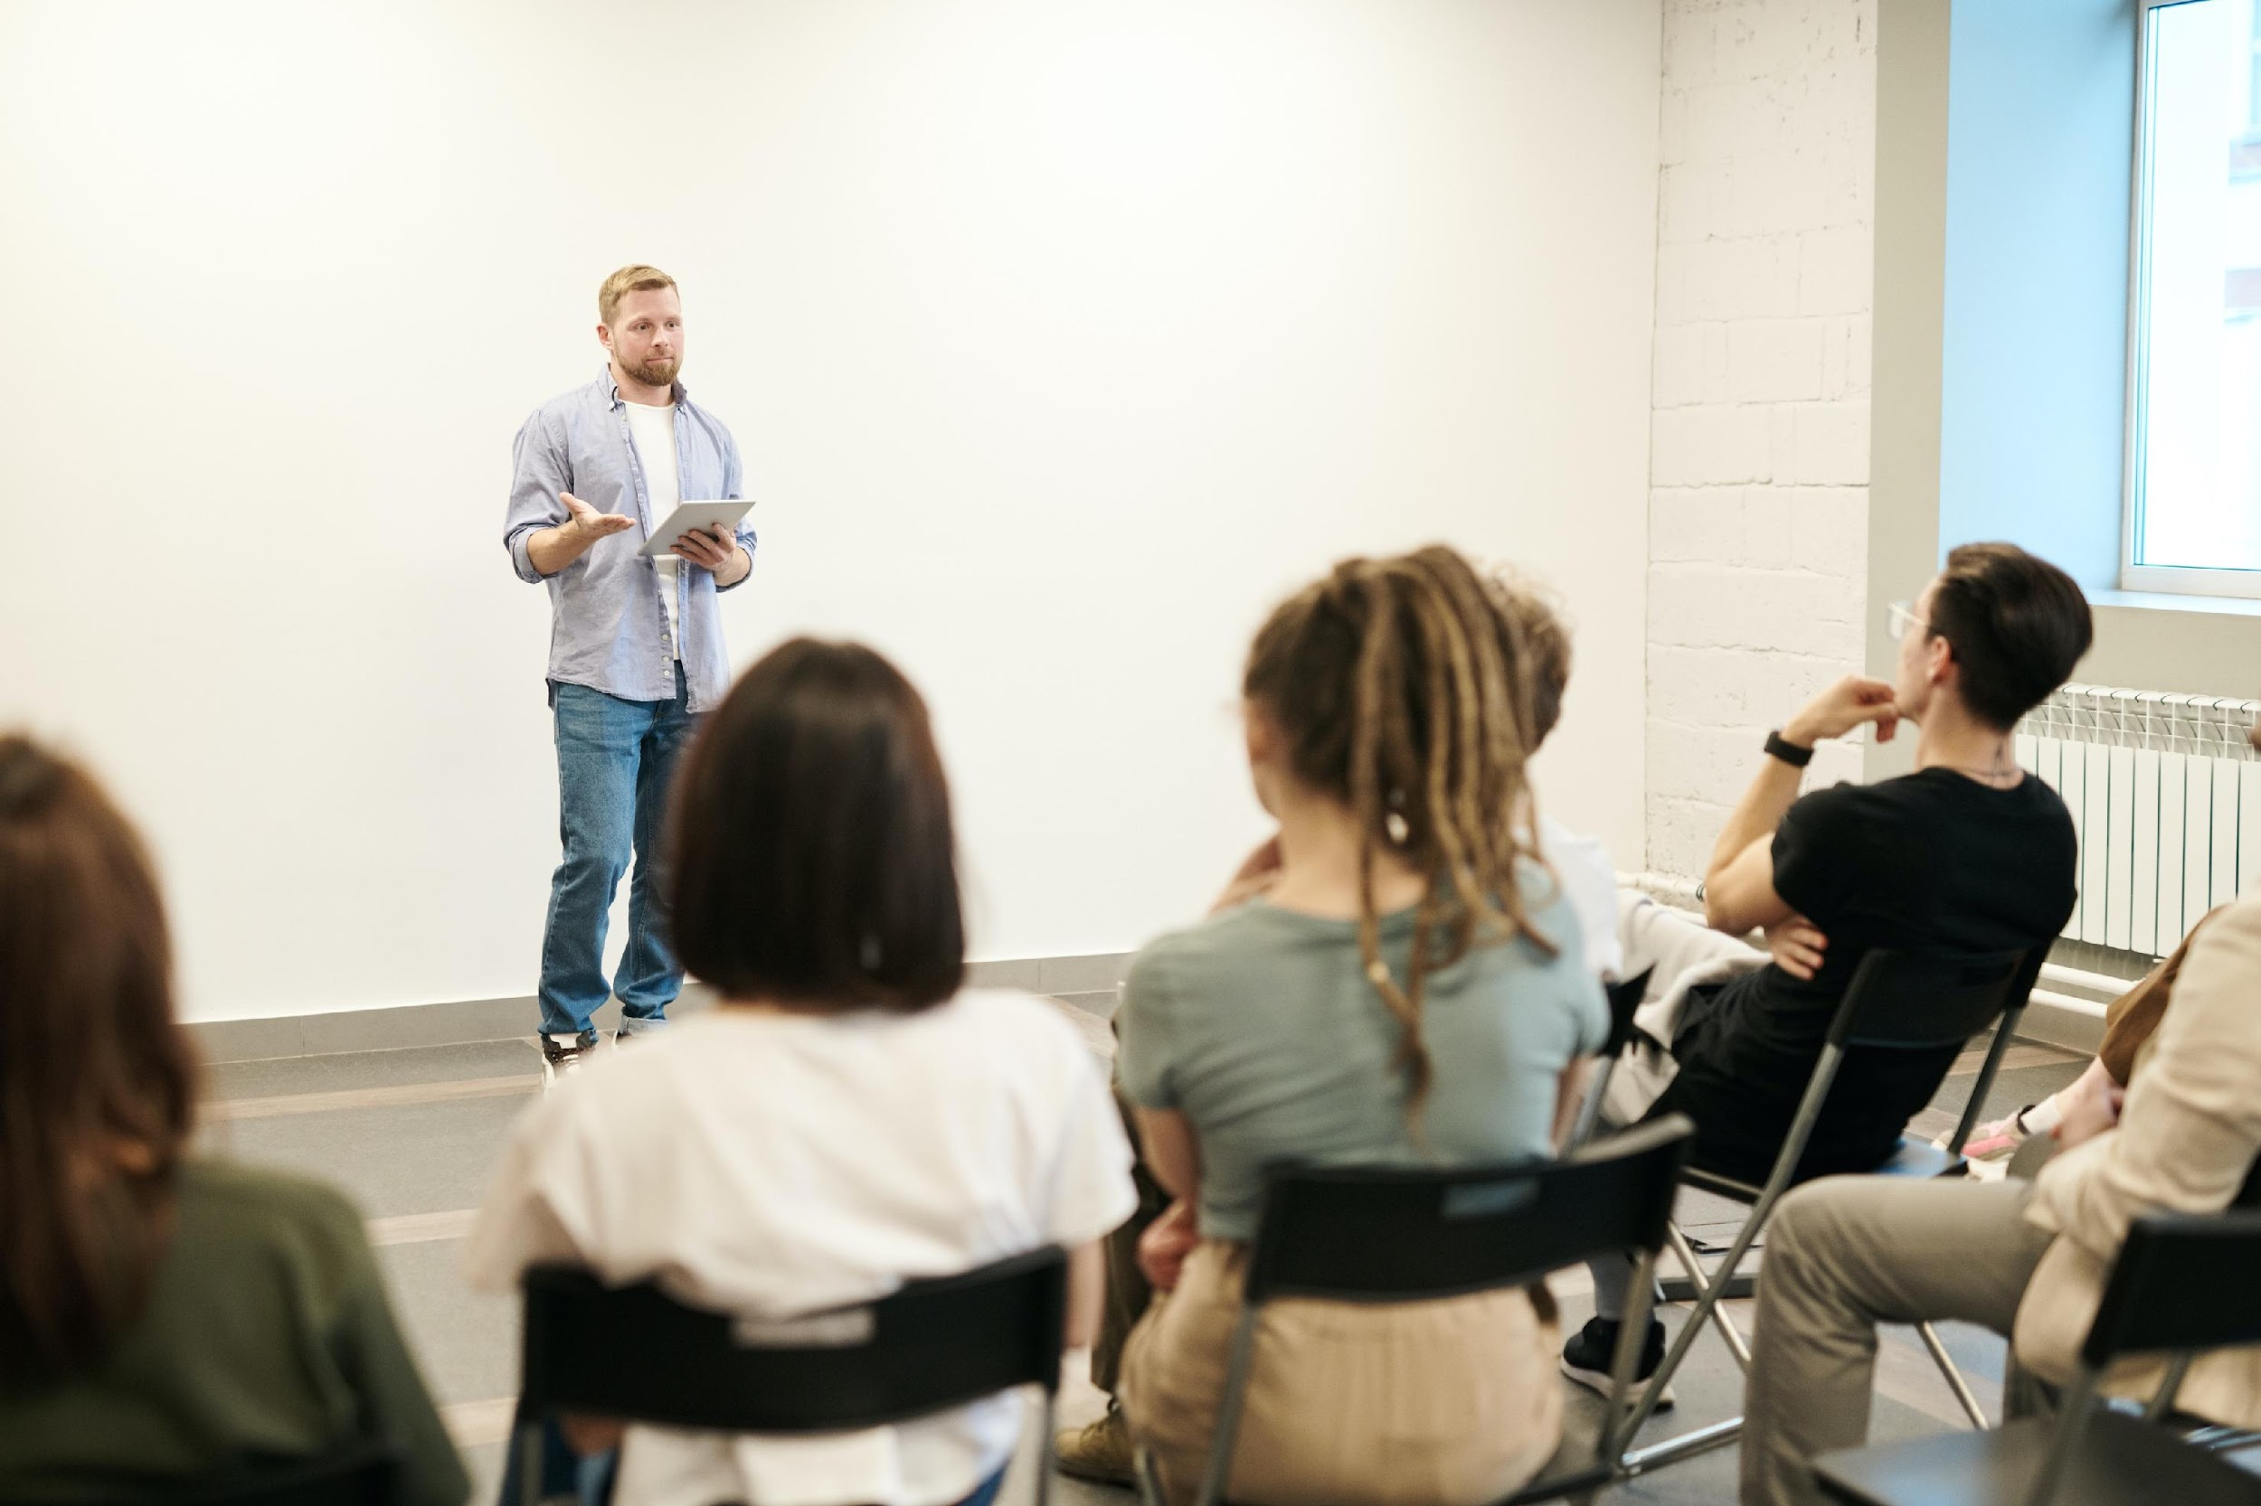
Projects & Events
Digital Democracy Lab
Third-party funded projects
Community meetings, Panel discussions, Brownbag, Workshops

Slide 4
DSI AI Meetup
Best Practices in Deploying AI at Scale
Presenters Maël Kubli (UZH)
Colin Henry (UZH)

